Slide 1
Test Automation & Advanced Selenium
Lesson 5: Testing Web Applications Using Web Driver API

Slide 2
Lesson Objectives
Writing first Web Driver Test
Locating UI Elements-Developers Tools
Navigation API
get
navigate
Interrogation API
getTitle
getCurrentUrl
getPageSource
WebElement API
findElement & findElements
By
id
xpath
cssSelector
className
linkText, name, tagName, partialLinkText

Slide 3
Lesson Objectives (Cont.)
WebElement API
click
clear
sendKeys
submit
Select – selectByVisibleText etc.
getText
getAttribute
Handling Popup Dialogs and Alerts
Windows
getWindowHandle and getWindowHandles
switchTo
manage
Alerts
switchTo
dismiss
accept
Why synchronization is important

Slide 4
Lesson Objectives (Cont.)
Using Explicit & Implicit Wait
Expected Condition & Expected Conditions
WebDriverWait
ImplicitlyWait
pageLoadTimeout
JavaScript Executor

Slide 5
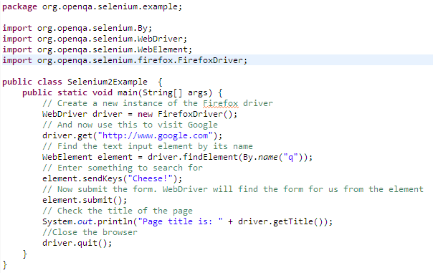
5.1: Testing Web Applications Using Web Driver API Writing first Web Driver Test(Java)

Slide 6
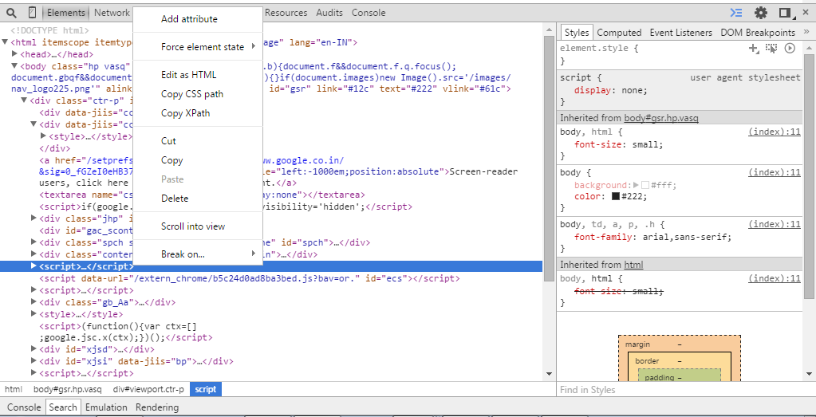
5.1: Testing Web Applications Using Web Driver API Locating UI Elements-Developers Tools

Slide 7
5.1: Testing Web Applications Using Web Driver API Navigation API
driver.get("URL")
Required to navigate to a page
E.g.: driver.get("http://www.google.com");
WebDriver will wait until the page has fully loaded before returning control to your test or script
to ensure page is fully loaded then wait commands can be used
driver.navigate().to("URL")
E.g.: driver.navigate().to("http://www.google.com");
Other Navigate commands
driver.navigate().refresh();
driver.navigate().forward();
driver.navigate().back();
Notes:
Single-Page Applications are an exception to this.
The difference between these two methods comes not from their behavior, but from the behavior in the way the application works and how browser deal with it.
navigate().to() navigates to the page by changing the URL like doing forward/backward navigation.
Whereas, get() refreshes the page to changing the URL.
So, in cases where application domain changes, both the method behaves similarly. That is, page is refreshed in both the cases. But, in single-page applications, while navigate().to() do not refreshes the page, get() do.
Moreover, this is the reason browser history is getting lost when get() is used due to application being refreshed.

Slide 8
5.1: Testing Web Applications Using Web Driver API Interrogation API
driver.getTitle()
Get the title of the current page
driver. getCurrentUrl()
Get the current URL of the browser
driver.getPageSource()
Get the source code of the page
Syntax:
public void testTitleReliability() {
driver.get("https://www.google.com");
boolean title = driver.getTitle().contains("Google");
if(title)
String currentURL = driver.getCurrentUrl();
(If you want to verify a particular text is present or not on the page,do as below)
boolean b = driver.getPageSource().contains("your text");
System.out.println(“Expected title is present ");
else if(!title)
System.out.println(" Expected title is not present"); ");
}

Slide 9
5.1: Testing Web Applications Using Web Driver API WebElement API
findElement:
Used to locate single element and return WebElement object of first occurrences element on web page
If element not found, throw s exception NoSuchElementException
Syntax: findElement(By by)
Example:
WebElement element = driver.findElement(By.id("Home"));
element.click();
findElements:
Used to find multiple element on webpage, e.g.: count total number of row in table
Returns List of WebElement object of all occurrences of element
If element not found, returns empty List of WebElement object
Syntax: List element = findElements(By by)
Example:
List {WebElement} element = driver.findElement(By.xpath("//table/tr"));
int size = element.size();

Slide 10
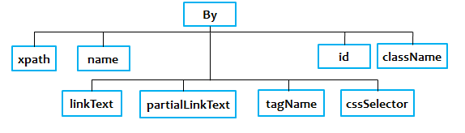
5.1: Testing Web Applications Using Web Driver API WebElement API (Cont.)
By:
A collection of factory functions for creating webdriver.Locator instances
By id: Locates an element by its ID
Syntax: driver.findElement(By.id("element id"))
By className: Locates elements that have a specific class name
Syntax : driver.findElement(By.className("element class"))
By name: Locates elements whose name attribute has the given value
Syntax : driver.findElement(By.name("element name"))

Slide 11
5.1: Testing Web Applications Using Web Driver API WebElement API (Cont.)
By XPath: Locates elements matching a XPath selector.
For example, given the selector "//div", WebDriver will search from the document root regardless of whether the locator was used with a WebElement
Syntax: driver.findElement(By.xpath("xpath expression"))
By linkText :Locates link elements whose visible text matches the given string
Syntax : driver.findElement(By.link("link text"))
By partialLinkText: Locates link elements whose visible text contains the given substring
Syntax : driver.findElement(By. partialLinkText("link text"))
By tagName: Locates elements with a given tag name.
The returned locator is equivalent to using the getElementsByTagName DOM function
Syntax : driver.findElement(By.tagName("element html tag name"))
By CSS Selector: Locates elements with a given tag name.
Syntax : driver.findElement(By.cssSelector("css selector"))
Notes:
CSS selectors for Selenium with example
When we don't have an option to choose Id or Name, we should prefer using CSS locators as the best alternative. CSS is "Cascading Style Sheets" and it is defined to display HTML in structured and colorful styles are applied to webpage.
Selectors are patterns that match against elements in a tree, and as such form one of several technologies that can be used to select nodes in an XML document. Visit to know more W3.Org Css selectors
CSS has more Advantage than Xpath
CSS is much more faster and simpler than the Xpath.
In IE Xpath works very slow, where as Css works faster when compared to Xpath.

Slide 12
5.1: Testing Web Applications Using Web Driver API WebElement API (Cont.)
Click():
For Example: Login button is available on login screen
Syntax:
WebElement click = driver.findElement(By.xpath("//*[@id='btnLogOn']"));
click.click();
Scenarios where Click() is used:
“Check / Uncheck “ a checkbox
Select a radio button
Clear():
Function sets the value property of the element to an empty string ('')
Syntax:
driver.findElement(By.xpath("//*[@id=“textBox”]")).clear();
SendKeys():
Method is used to simulate typing into an element, which may set its value
Syntax:
driver.findElement(By.id(“NameTextBox")).sendKeys(“Rahul”);
Notes:
Click():
Click a link / button:
To click on an object through webdriver first we need to find out which locator we are going to use. Is it ID, name, xpath, or css? For this purpose we can utilize firebug / xpath checker to find out is there any id / name exists for the object we are going to perform action upon. Then write the code as below:
driver.findElement(By.xpath("//a[@href='CustomerInfo.htm']")).click();
In the above line of code “driver” could be FirefoxDriver, InternetExplorerDriver, ChromeDriver, HtmlUnitDriver, etc. On one of these browsers we are going to find an element and then click as per the code.
findElement is an API provided by the webdriver which requires argument “By.xpath”. The “xpath” can be replaced by one of the below methods if we need to identify the element with any other attributes such as css, name, classname, etc.
“Check / Uncheck “ a checkbox
To “Check / Uncheck” a checkbox, the object needs to be identified using findElement method and then just click. To find out whether the checkbox is checked or not utilize the method – element.isSelected()
WebElement kancheck = driver.findElement(By.name("kannada"));
kancheck.click();
System.out.println(kancheck.isSelected());
Above code snippet will first click the checkbox named kannada and then verifies whether it is clicked or not.

Slide 13
Notes:
Select a radio button
Follow the same steps which are used in Checkbox to select a radio button and then verify the status using isSelected() method.
WebElement gender = driver.findElement(By.xpath("//input[@name='male']"));
gender.click();
System.out.println(gender.isSelected());
Clear();
The clear() method executes an "Automation Atom", which is a JavaScript function intended to provide the smallest basic unit of automation functionality for a browser. In the case of clear(), that function sets the value property of the element to an empty string (''), then fires the onchange event on the element. The atoms function you're interested in is bot.action.clear()
click
clear
sendKeys
submit
Select – selectByVisibleText etc.
getText
getAttribute

Slide 14
5.1: Testing Web Applications Using Web Driver API WebElement API (Cont.)
SendKeys():
Scenarios where sendKeys() is used:
Sending special characters (Enter , F5, Ctrl, Alt etc..)
Key events to WebDriver
Uploading a file
Syntax:
//Sending Ctrl+A
driver.findElement(By.xpath("//body")).sendKeys(Keys.chord(Keys.CONTROL, "a"));
//Sending pagedown key from keyboard
driver.findElement(By.id("name")).sendKeys(Keys.PAGE_DOWN);
//Sending space key
driver.findElement(By.id("name")).sendKeys(Keys.SPACE);
Submit():
If form has submit button which has type = “submit” instead of type = "button" then .submit() method will work
If button Is not Inside <form> tag then .submit() method will not work.
Syntax:
driver.findElement(By.xpath("//input[@name='Company']")).submit();
Notes:
When to use .click() method
You can use .click() method to click on any button of software web application. Means element's type = "button" or type = "submit", .click() method will works for both.
When to use .submit() method
If you will look at firebug view for any form's submit button then always It's type will be "submit". In this case, .submit() method Is very good alternative of .click() method.

Slide 15
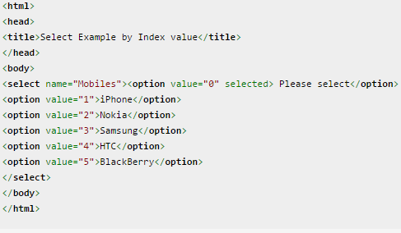
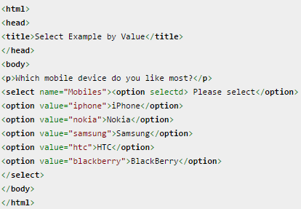
5.1: Testing Web Applications Using Web Driver API WebElement API (Cont.)
Select:
WebDriver’s support classes
Used to work with Dropdowns
Method Name: selectByIndex
Syntax: select.selectByIndex(Index);
Method Name: selectByValue
Syntax: select.selectByValue(Value);
Method Name: selectByVisibleText
Syntax: select.selectByVisibleText(Text);
Notes:
Method Name: selectByIndex
Purpose: To Select the option based on the index given by the user. There is an attribute called "values" which will have the index values.
Example:
WebElement element=driver.findElement(By.name("Mobiles"));
Select se=new Select(element);
se.selectByIndex(1);
Method Name: selectByValue
Purpose: To Select the options that have a value matching with the given argument by the user.
Example:
WebElement element=driver.findElement(By.name("Mobiles"));
Select se=new Select(element);
se.selectByValue("nokia");
Method Name: selectByVisibleText
Purpose: To Select all options that display text matching the given argument. It will not look for any index or value, it will try to match the VisibleText (which will display in dropdown)
Example:
WebElement element=driver.findElement(By.name("Mobiles"));
Select se=new Select(element);
se.selectByVisibleText("HTC");

Slide 16
Notes:
Method Name: deselectByIndex
Purpose: To Deselect the option at the given index. The user has to provide the value of index.
Example:
se.deselectByIndex(1);
Method Name: deselectByValue
Purpose: To Deselect all options that have a value matching the given argument.
Example:
se.deselectByValue("nokia");
Method Name: deselectByVisibleText
Purpose: To Deselect all options that display text matching the given argument.
Example:
se.deselectByVisibleText("HTC");
Method Name: deselectAll
Purpose: To Clear all selected entries. This works only when the SELECT supports multiple selections. It throws NotImplemented eError if the "SELECT" does not support multiple selections. In select it mandatory to have an attribute multiple="multiple“
Example:
se.deselectAll();

Slide 17
5.1: Testing Web Applications Using Web Driver API WebElement API (Cont.)
getText():
Get the text content from a DOM-element found by given selector
Make sure the element you want to request the text from is interact able otherwise empty string is returned
Syntax:
WebElement TxtBoxContent = driver.findElement(By.id(“WebelementID”));
TxtBoxContent.getText();
getAttribute():
getText() will only get the inner text of an element
To get the value, you need to use getAttribute(“attribute name”)
Attribute name can be class, id, name, status etc
Syntax:
WebElement TxtBoxContent = driver.findElement(By.id(WebelementID)); System.out.println("Printing " + TxtBoxContent.getAttribute(“class"));
Notes:
When to use .click() method
You can use .click() method to click on any button of software web application. Means element's type = "button" or type = "submit", .click() method will works for both.
When to use .submit() method
If you will look at firebug view for any form's submit button then always It's type will be "submit". In this case, .submit() method Is very good alternative of .click() method.

Slide 18
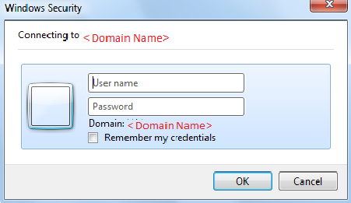
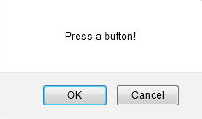
5.1: Testing Web Applications Using Web Driver API Handling Popup Dialogs and Alerts
Two types of alerts:
Windows based alert pop ups
Selenium will not be able to recognize it, since it is an OS-level dialog
Web based alert pop ups
Can be Alert box/ Pop up box/ confirmation Box/ Prompt/ Authentication Box
Alert interface gives us following methods to deal with the alert
accept() : To accept the alert
dismiss() : To dismiss the alert
getText() : To get the text of the alert
sendKeys() : To write some text to the alert
Notes:
Simple alert
Simple alerts just have a OK button on them. They are mainly used to display some information to the user.
Confirmation Alert
This alert comes with an option to accept or dismiss the alert. To accept the alert you can use Alert.accept() and to dismiss you can use the Alert.dismiss().
Prompt Alerts
In prompt alerts you get an option to add text to the alert box. This is specifically used when some input is required from the user. We will use the sendKeys() method to type something in the Prompt alert box.

Slide 19
5.1: Testing Web Applications Using Web Driver API Windows
Multiple windows are handled by switching the focus from one window to another
Syntax:
// Opening site
driver.findElement(By.xpath("//img[@alt='SeleniumMasterLogo']")).click();
// Storing parent window reference into a String Variable
String Parent_Window = driver.getWindowHandle();
// Switching from parent window to child window
for (String Child_Window : driver.getWindowHandles())
{
driver.switchTo().window(Child_Window);
// Performing actions on child window
driver.findElement(By.id("dropdown_txt")).click();
driver.findElement(By.xpath("//*[@id='anotherItemDiv']")).click();
}
//Switching back to Parent Window
driver.switchTo().window(Parent_Window);
//Performing some actions on Parent Window
driver.findElement(By.className("btn_style")).click();
Notes:
Steps for understanding window handling:
Window A has a link "Link1" and we need to click on the link (click event).
Window B displays and we perform some actions.
The entire process can be fundamentally segregated into following steps:
Step 1 : Clicking on Link1 on Window A
A new Window B is opened.
Step 2 : Save reference for Window A
Step 3 : Create reference for Window B
Step 4 : Move Focus from Window A to Window B
Window B is active now
Step 5 : Perform Actions on Window B
Complete the entire set of Actions
Step 6 : Move Focus from Window B to Window A
Window A is active now

Slide 20
5.1: Testing Web Applications Using Web Driver API Alerts
Present in the org.openqa.selenium.Alert package
Syntax:
Alert simpleAlert = driver.switchTo().alert(); //switch from main window to an alert
String alertText = simpleAlert.getText(); //To get the text present on alert
System.out.println("Alert text is " + alertText);
//Simple alert
simpleAlert.accept(); //To click on ‘Ok’/’Yes’ on Alert
OR
//Confirmation Alert
simpleAlert. dismiss(); //To click on ‘Cancel’/’No’ on Alert
OR
//Prompt Alerts
simpleAlert. sendKeys("Accepting the alert"); //Send some text to the alert
Notes:
Alerts are different from regular windows. The main difference is that alerts are blocking in nature. They will not allow any action on the underlying webpage if they are present. So if an alert is present on the webpage and you try to access any of the element in the underlying page you will get following exception: UnhandledAlertException: Modal dialog present

Slide 21
5.1: Testing Web Applications Using Web Driver API Why synchronization is important
“Mechanism which involves more than one components to work parallel with each other”
Every time user performs an operation on the browser, one of the following happens:
The request goes all the way to server and entire DOM is refreshed when response comes back
The request hits the server and only partial DOM gets refreshed (Ajax requests or asynchronous JavaScript calls)
The request is processed on the client side itself by JavaScript functions
So if we think about the overall workflow, there is a need of certain synchronization that happens between the client(aka. browser) and the server (the url)

Slide 22
5.1: Testing Web Applications Using Web Driver API Using Explicit & Implicit Wait
Implicit Wait
Element Synchronization
Default element existence timeout can be set
Below statement will set the default object synchronization timeout as 20
Means that selenium script will wait for maximum 20 seconds for element to exist
If Web element does not exist within 20 seconds, it will throw an exception
driver.manage().timeouts().implicitlyWait(20, TimeUnit.SECONDS);
Notes:
Synchronization can be classified into two categories:
1. Unconditional
2. Conditional Synchronization
Unconditional :
In this we just specify timeout value only. We will make the tool to wait until certain amount of time and then proceed further.
Examples: Wait() and Thread.Sleep();
The main disadvantage for the above statements are, there is a chance of unnecessary waiting time even though the application is ready.
The advantages are like in a situation where we interact for third party systems like interfaces, it is not possible to write a condition or check for a condition. Here in this situations, we have to make the application to wait for certain amount of time by specifying the timeout value.
Conditional Synchronization:
We specify a condition along with timeout value, so that tool waits to check for the condition and then come out if nothing happens.
It is very important to set the timeout value in conditional synchronization, because the tool should proceed further instead of making the tool to wait for a particular condition to satisfy.
In Selenium we have implicit Wait and Explicit Wait conditional statements

Slide 23
5.1: Testing Web Applications Using Web Driver API Using Explicit & Implicit Wait
Explicit Wait
Specific condition synchronization
Instruct selenium to wait until element is in expected condition
Syntax:
WebDriverWait w = new WebDriverWait(driver,20);
w.ignoring(NoSuchElementException.class);
WebElement P = null;
//below statement will wait until element becomes visible P=w.until(ExpectedConditions.visibilityOfElementLocated(By.id("x")));
//below statement will wait until element becomes clickable.
P= w.until(ExpectedConditions.elementToBeClickable(By.id("ss")));
Notes:
Page Load Synchronization:
Default page navigation timeout can be set.
Below statement will set the navigation timeout as 50
Means that selenium script will wait for maximum 50 seconds for page to load
If page does not load within 50 seconds, it will throw an exception
Syntax
driver.manage().timeouts().pageLoadTimeout(50,TimeUnit.SECONDS);

Slide 24
5.1: Testing Web Applications Using Web Driver API JavaScript Executor
An interface which provides mechanism to execute Javascript through selenium driver
Provides “executescript” & "executeAsyncScript" methods, to run JavaScript in the context of the currently selected frame or window
Used to enhance the capabilities of the existing scripts by performing Javascript injection into our application under test
Package import org.openqa.selenium.JavascriptExecutor; Syntax JavascriptExecutor js = (JavascriptExecutor) driver;
js.executeScript(Script,Arguments);
script - The JavaScript to execute Arguments - The arguments to the script.(Optional)
Notes:
Add instructor notes here.

Slide 25
5.1: Testing Web Applications Using Web Driver API JavaScript Executor(Scenarios)
How to generate Alert Pop window in selenium?
Code:
JavascriptExecutor js = (JavascriptExecutor)driver
Js.executeScript("alert('hello world');");
How to click a button in Selenium WebDriver using JavaScript? Code: JavascriptExecutor js = (JavascriptExecutor)driver;
js.executeScript("arguments[0].click();", element);
How to refresh browser window using Javascript ?
Code:
JavascriptExecutor js = (JavascriptExecutor)driver;
driver.executeScript("history.go(0)");
Notes:
Add instructor notes here.

Slide 26
5.1: Testing Web Applications Using Web Driver API JavaScript Executor(Scenarios)
How to get innertext of the entire webpage in Selenium? Code: JavascriptExecutor js = (JavascriptExecutor)driver;
string sText = js.executeScript("return document.documentElement.innerText;").toString();
How to get the Title of our webpage ? Code: JavascriptExecutor js = (JavascriptExecutor)driver;
string sText = js.executeScript("return document.title;").toString();
Notes:
Add instructor notes here.

Slide 27
5.1: Testing Web Applications Using Web Driver API JavaScript Executor(Scenarios)
How to perform Scroll on application using Selenium? Code: JavascriptExecutor js = (JavascriptExecutor)driver; //Vertical scroll - down by 50 pixels js.executeScript("window.scrollBy(0,50)");
Note: for scrolling till the bottom of the page we can use the code: js.executeScript("window.scrollBy(0,document.body.scrollHeight)");
Notes:
Add instructor notes here.

Slide 28
5.1: Testing Web Applications Using Web Driver API JavaScript Executor(Scenarios)
How to click on a Sub Menu which is only visible on mouse hover on Menu? Code: JavascriptExecutor js = (JavascriptExecutor)driver;
//Hover on Automation Menu on the Menu Bar
js.executeScript("$('ul.menus.menu-secondary.sf-js-enabled.sub-menu li').hover()");
How to navigate to different page using Javascript? Code: JavascriptExecutor js = (JavascriptExecutor)driver; //Navigate to new Page js.executeScript("window.location = 'https://www.facebook.com/uftHelp'");
Notes:
Add instructor notes here.

Slide 29
Summary
In this lesson, you have learnt
Multiple windows are handled by switching the focus from one window to another.
By is a collection of factory functions for creating webdriver.Locator instances.
Alert contains methods for dismissing, accepting, inputting, and getting text from alert prompts.
Explicit synchronization points are inserted in the script using WebDriverWait class.
Each and every time when there is need to match speed of the application and speed of test execution we have to use thread.sleep().
The implicit wait will not wait for the entire time that is specified, rather it will only wait, until the entire page is loaded.
Notes:
Add the notes here.

Slide 30
Summary
In this lesson, you have learnt
An interface which provides mechanism to execute Javascript through selenium driver
Used to click on a Sub Menu which is only visible on mouse hover on Menu
Used to to get innertext of the entire webpage in Selenium
Used to navigate to different page using Javascript
Used to click a button in Selenium WebDriver using JavaScript
Notes:
Add the notes here.

Slide 31
Review Question
Question 1
Select which is NOT an Explicit Wait
VisibilityOfElementLocated
ElementToBeClickable
PageLoadTimeout
None of the above
Question 2: True/False
The syntax is correct:
Syntax : driver.findElement(By. PartialLinkText("link text"));
Question 3: Fill in the Blanks
findElements is used to find ______ element on webpage

Slide 32
Review Question
Question 4: True/False
The syntax is correct:
Syntax :
JavascriptExecutor js = (JavascriptExecutor)driver;
Question 5: Fill in the Blanks
An interface which provides mechanism to execute ___________ through selenium driver
Notes:
Answer 1:
True
Answer 2:
Javascript

